Slide 1
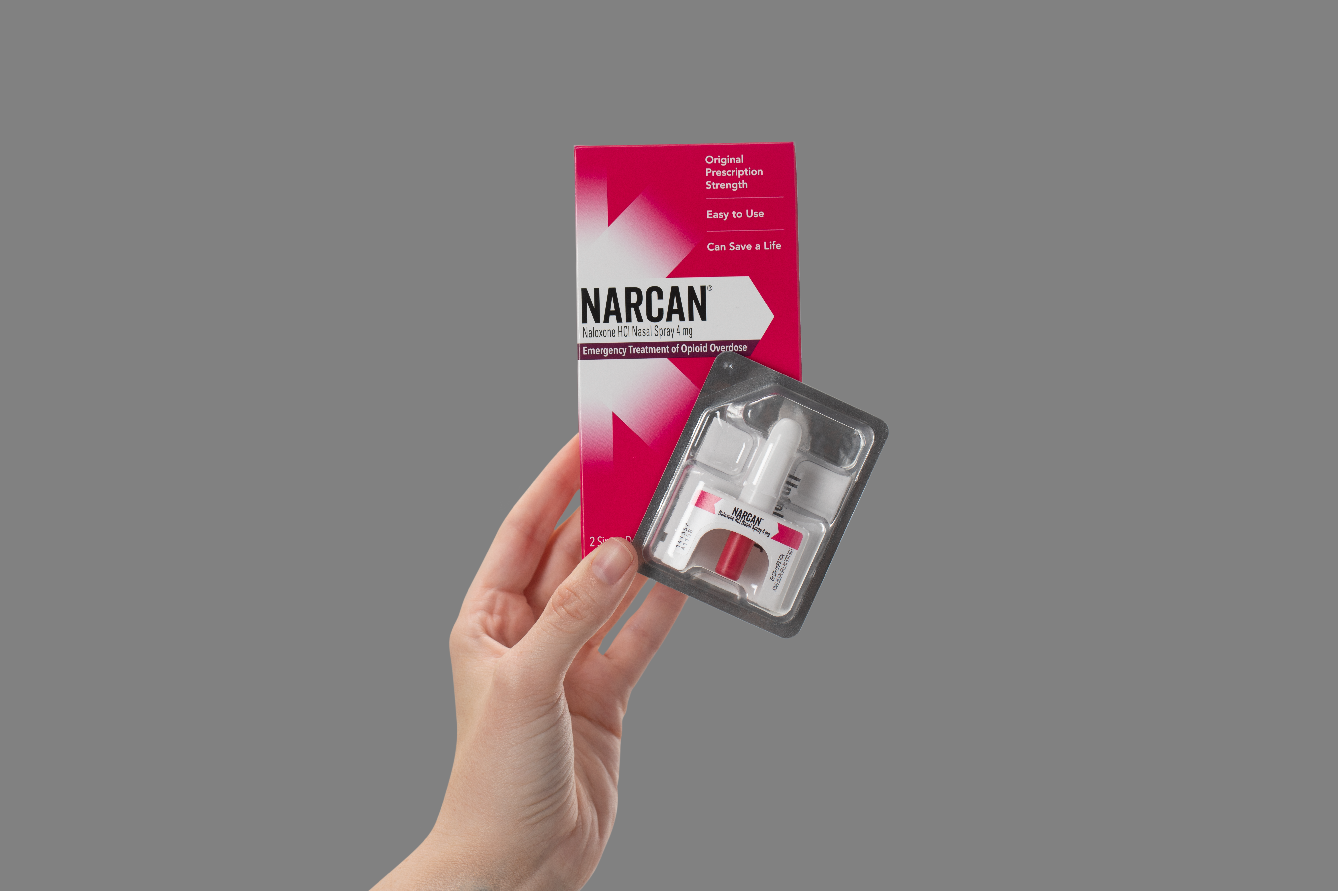
Naloxone: A harm reduction tool everyone should know about.
Image courtesy of Emergent
Notes:
Suggested Caption: Naloxone is a common form of harm reduction. Check out these frequently asked questions, then learn more about how naloxone saves lives at https://www.samhsa.gov/medications-substance-use-disorders/medications-counseling-related-conditions/opioid-overdose-reversal-medications/over-the-counter-naloxone-faqs
Note: These graphic are intended to be posted all together.

Slide 2
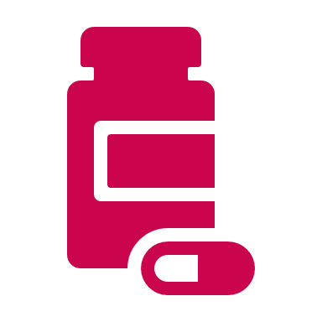
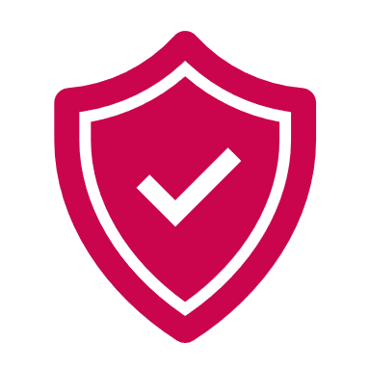
What is naloxone?
A medicine that reverses the short-term effects of an opioid overdose.
Can naloxone hurt someone?
No, even if a person is not experiencing an overdose naloxone will not harm them.
Who can get naloxone?
Anyone! The medicine is for purchase available for purchase and for free at many locations.
Notes:
Suggested Caption: Naloxone is a common form of harm reduction. Check out these frequently asked questions, then learn more about how naloxone saves lives at https://www.samhsa.gov/medications-substance-use-disorders/medications-counseling-related-conditions/opioid-overdose-reversal-medications/over-the-counter-naloxone-faqs
Note: These graphic are intended to be posted all together.

Slide 3
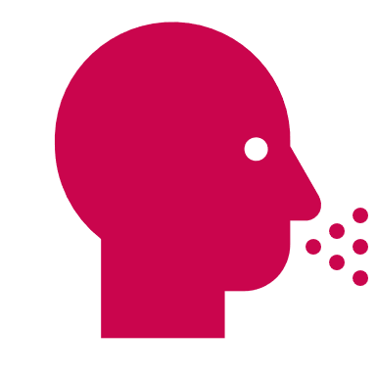
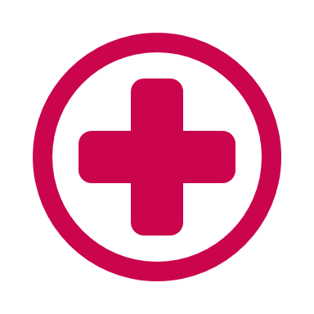
How is naloxone given?
It most commonly comes as a nasal spray, but naloxone is also available as an injection.
How can naloxone save a life?
Naloxone helps someone experiencing an overdose to start breathing again until help arrives.
What is naloxone also know as?
Brand names of naloxone include NARCAN® Nasal Spray, Kloxxado, and Rezenopy.
Notes:
Suggested Caption: Naloxone is a common form of harm reduction. Check out these frequently asked questions, then learn more about how naloxone saves lives at https://www.samhsa.gov/medications-substance-use-disorders/medications-counseling-related-conditions/opioid-overdose-reversal-medications/over-the-counter-naloxone-faqs
Note: These graphic are intended to be posted all together.

